Slide 1
COVID-19 Data Analysis and forecasting
Find Your Neighborhood Analysis

Slide 2
Predicting The number of COVID-19 cases
The model shows the current Covid positive people , number of people of died out of Covid and the people who recovered from Covid.
Here we can search the spots we want to know the count of and get the results.
The model also predicts the future number of confirmed, recovered and deaths due to COVID-19.

Slide 3
Data Acquisition and Datasets
The data section includes the foursquare API to search for a particular place and inform us about the number of COVID positives in the state. I used the Foursquare API through the venues channel. I used the near query to get venues in the city. Other data sets being used are also attached in the GitHub link additionally.

Slide 4
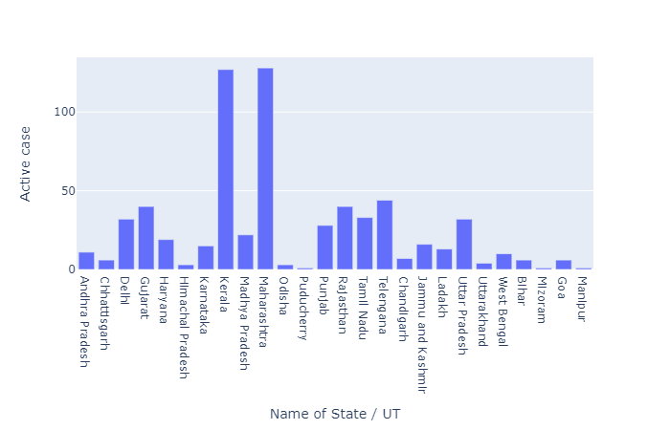
Total number of active cases in the country as per available dataset

Slide 5
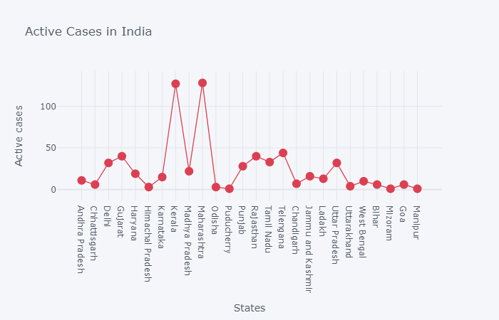
Gives the data for searched results

Slide 6
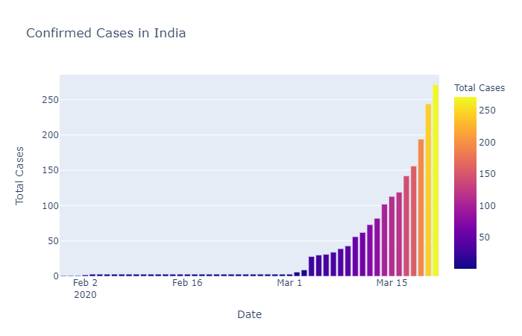
Total Confirmed cases in the Country

Slide 7
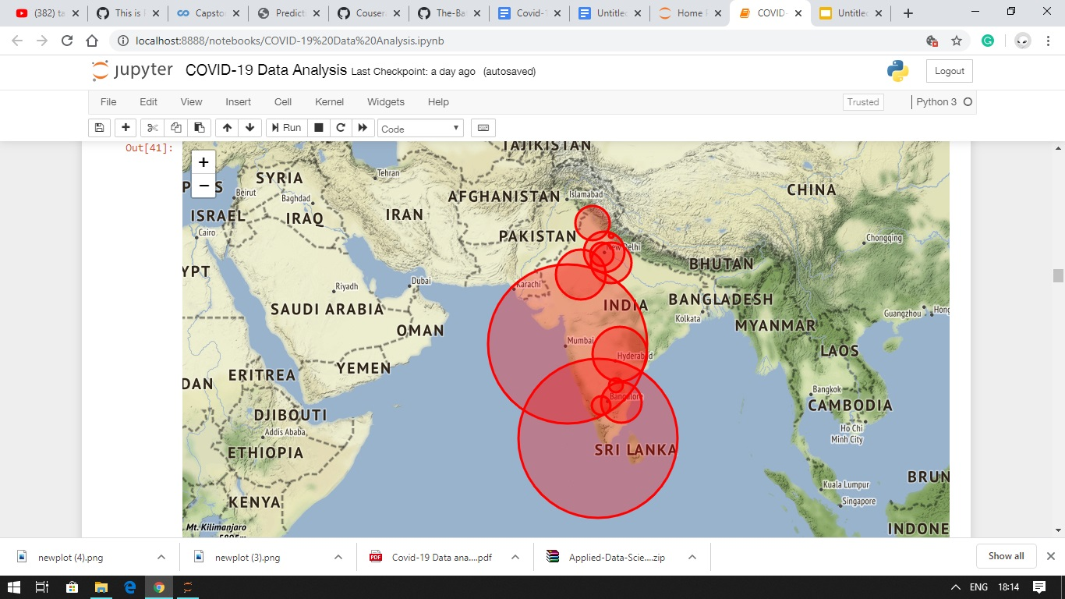

Slide 8
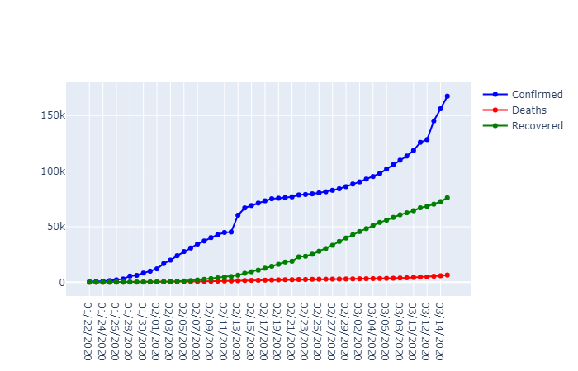
Confirmed, Deaths and recovered cases in the country

Slide 9
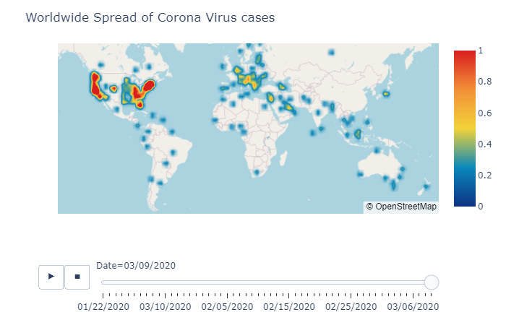
Worldwide Spread of COVID-19

Slide 10
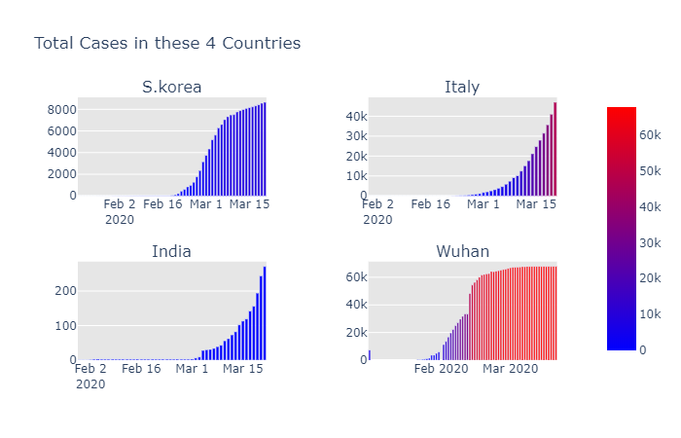
Final comparison with other countries

Slide 11
Conclusion and Forecasting
The conclusion we obtain is that Maharastra is the most infected state in our country and has a wider range of contribution to the country. So, before visiting any place we must check the COVID positive count there and also the relevant future predictions.
The forecasting is done with the help of facebook framework called Prophet.

